Slide 1


Deep Inspect (Deep Fake Audio Detection & Collection)
FYP-Phase II Group 6 – BSCS 8 C
18680 - Noor ul Islam Huzaifa
18317 - Talal Manshoor

Slide 2
Table of contents
01
05
02
06
03
04
Introduction
AI/ML Model
Problem Statement
System Architecture
Project Demo
07
Conclusion
FastAPI Backend
08
QA

Slide 3



01
Introduction

Slide 4

Introduction
What is Deep Inspect ?
Deep Inspect is a comprehensive solution for identifying deepfake audio files. The aim of Deep Inspect is to provide a user-friendly and effective tool for enhancing audio security and ensuring the authenticity of recorded voices.

Slide 5
Introduction
What is Deep Inspect Platform?
Accessible Chrome extension for recording/uploading WAV files.
Implementation of a Python backend for data upload, processing, and collection.
Utilization of an SVC-based AI/ML model to predict the presence of deep fake audio.

Slide 6
02
Problem Statement

Slide 7
Problem Statement
Problem
The goal
Deepfake audio technology, which creates realistic synthetic speech, poses significant security, trust, and privacy challenges. It can facilitate fraud, spread misinformation, and erode trust in communication. The unauthorized use of voices invades privacy and causes psychological distress.
As the technology evolves, there is an urgent need for effective detection and regulatory measures to counter these threats and protect individuals and institutions.

Slide 8
How do we know ??

Slide 9
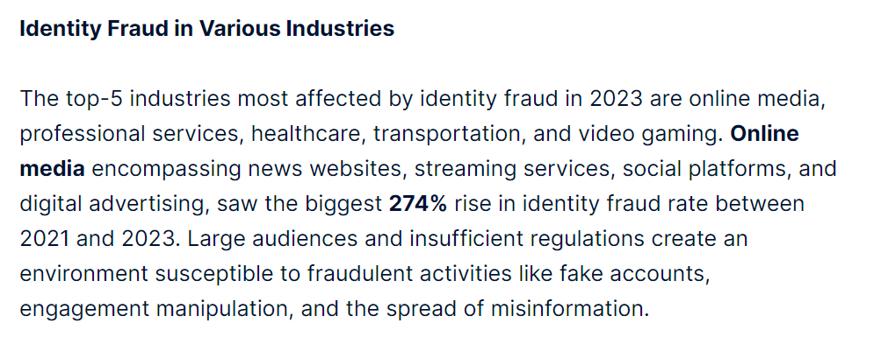
Sumsub Research: Global Deepfake Incidents Surge Tenfold from 2022 to 2023
Ref. to Article

Slide 10
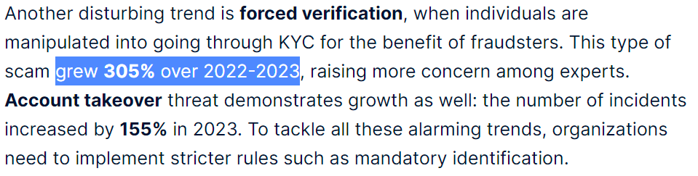
Sumsub Research: Global Deepfake Incidents Surge Tenfold from 2022 to 2023
Ref. to Article

Slide 11
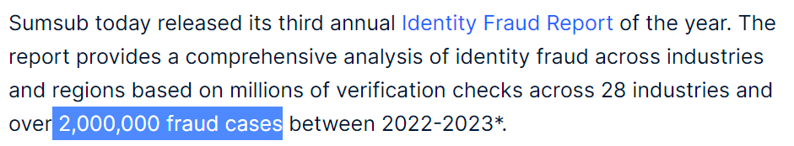
Sumsub Research: Global Deepfake Incidents Surge Tenfold from 2022 to 2023
Ref. to Article

Slide 12
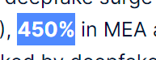
Sumsub Research: Global Deepfake Incidents Surge Tenfold from 2022 to 2023
Ref. to Article

Slide 13
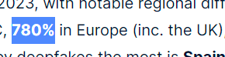
Sumsub Research: Global Deepfake Incidents Surge Tenfold from 2022 to 2023
Ref. to Article

Slide 14
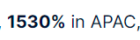
Sumsub Research: Global Deepfake Incidents Surge Tenfold from 2022 to 2023
Ref. to Article

Slide 15
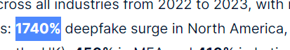
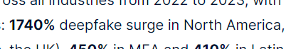
Sumsub Research: Global Deepfake Incidents Surge Tenfold from 2022 to 2023
Ref. to Article

Slide 16
Rs 1.8 Crore
PKR 1,00,000 1740% profit over a year

Slide 17
Solution ??

Slide 18
Deep Inspect

Slide 19
Deep Inspect
Deep Inspect combats deepfake audio threats with a user-friendly Chrome extension and a robust backend. It processes and analyzes audio files using an SVC-based AI/ML model to detect deepfakes accurately.
With this tool you can enhance security, maintain trust, and protect privacy by ensuring the authenticity of audio communications.

Slide 20
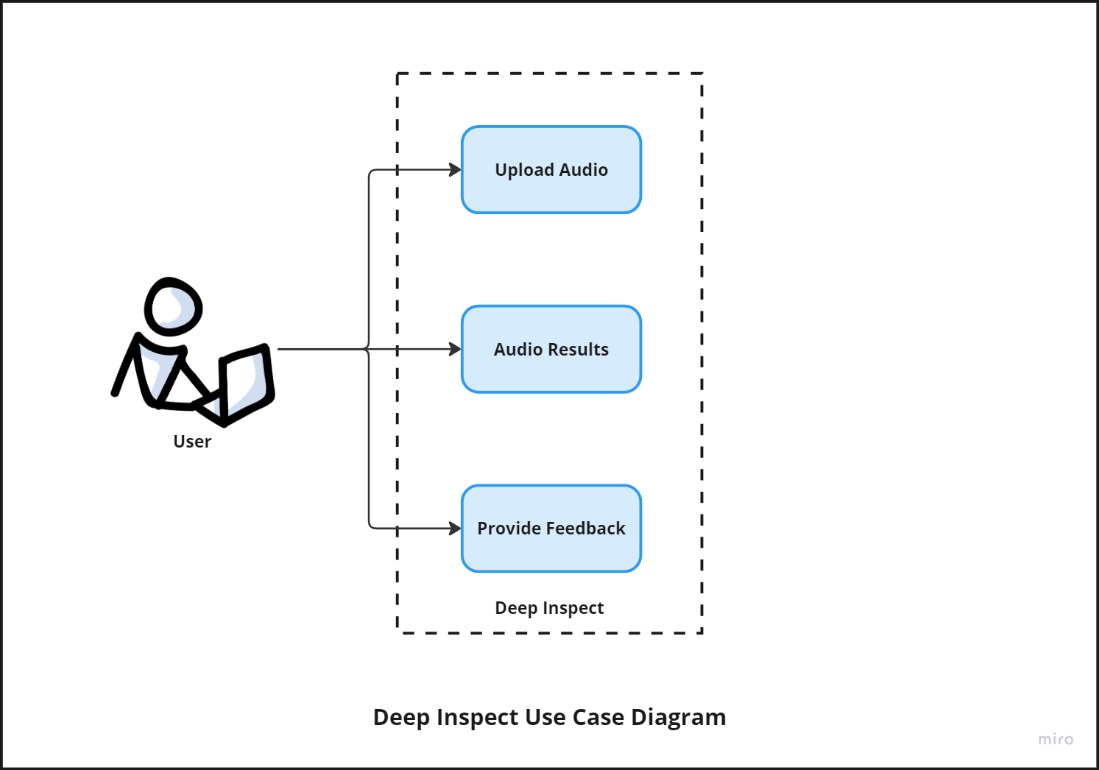
What you will get…

Slide 21
03
Chrome Extension

Slide 22
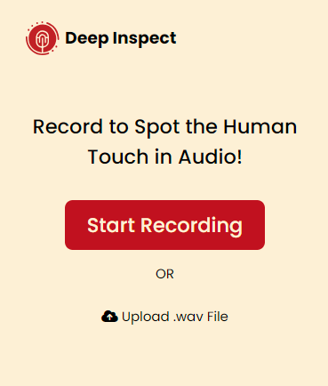
Chrome Extension
Why an extension ?
Accessibility: User interface for recording/uploading audio files.
Low-code: Manages file uploads, processes audio, and extracts features.
Availability : SVM classifier to predict deepfake audio.

Slide 23
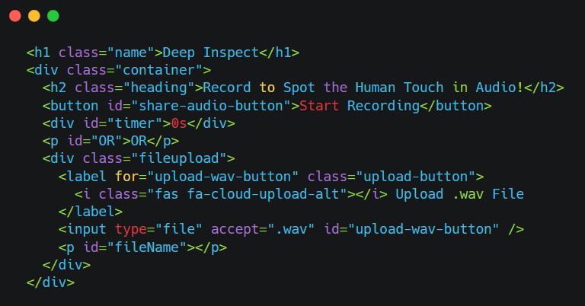
Chrome Extension

Slide 24
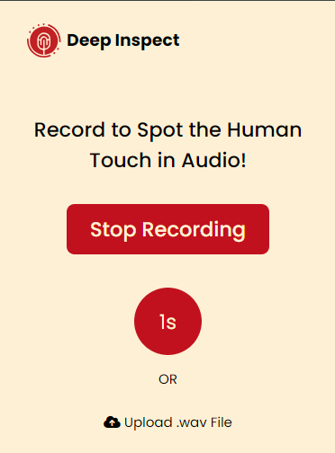
Chrome Extension

Slide 25
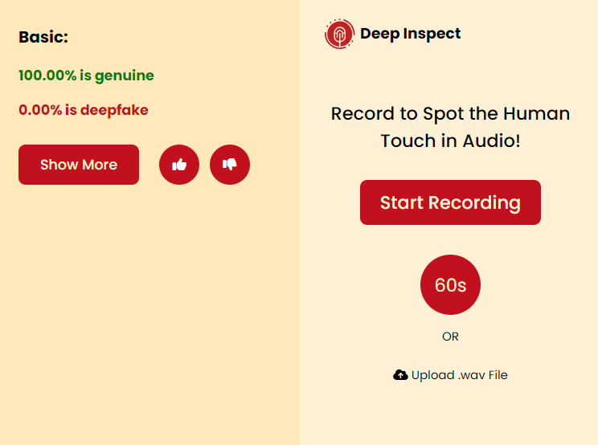
Chrome Extension

Slide 26
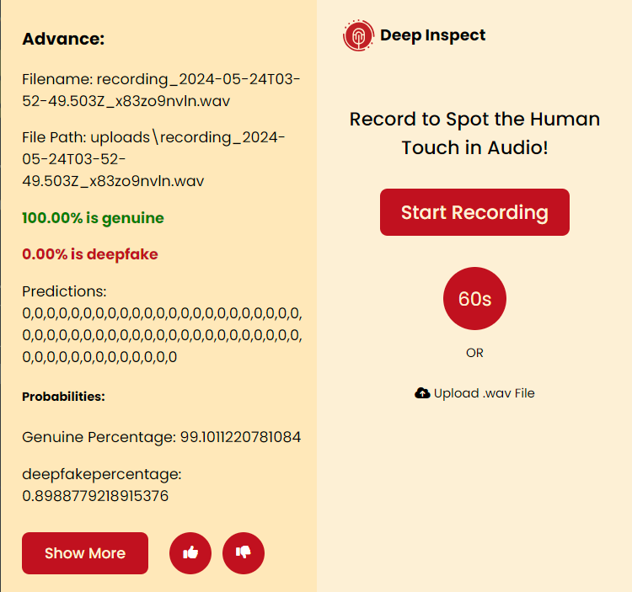
Chrome Extension

Slide 27
04
FastAPI Backend

Slide 28
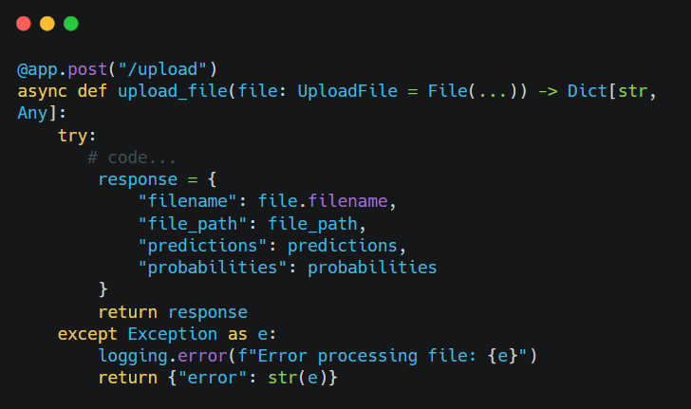
FastAPI Backend

Slide 29
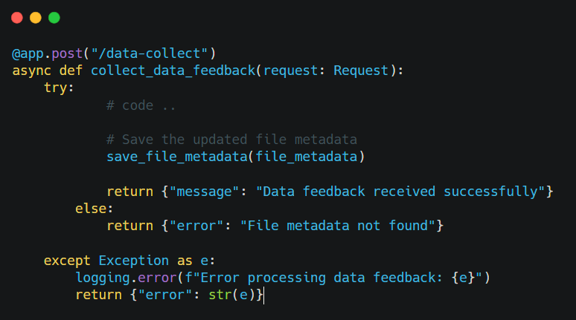
FastAPI Backend

Slide 30
05
AI/ML Model

Slide 31
AI/ML model
SVC benefits
Features
Parametric Algorithm
Use Hyperplane Support vectors
Memory efficient
MFCCs
LPCCs
Voicing Onset Time
Onset Periodicity
Burst Time

Slide 32
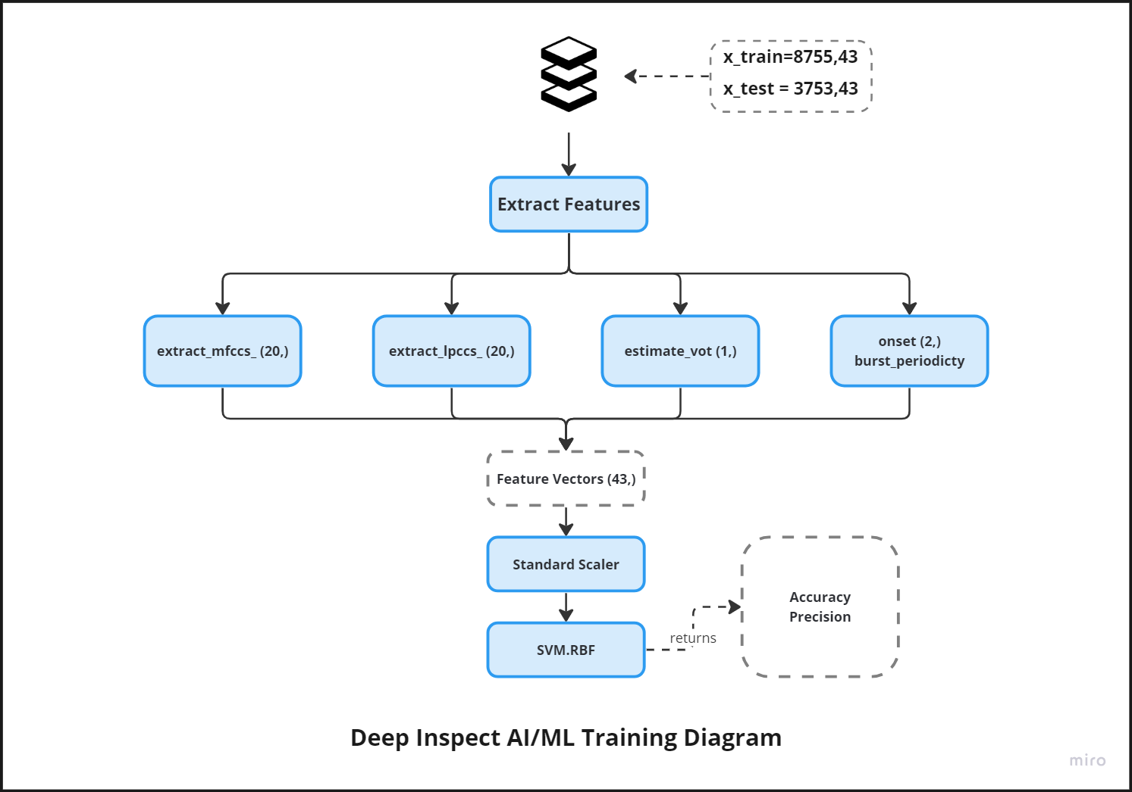
AI/ML model

Slide 33
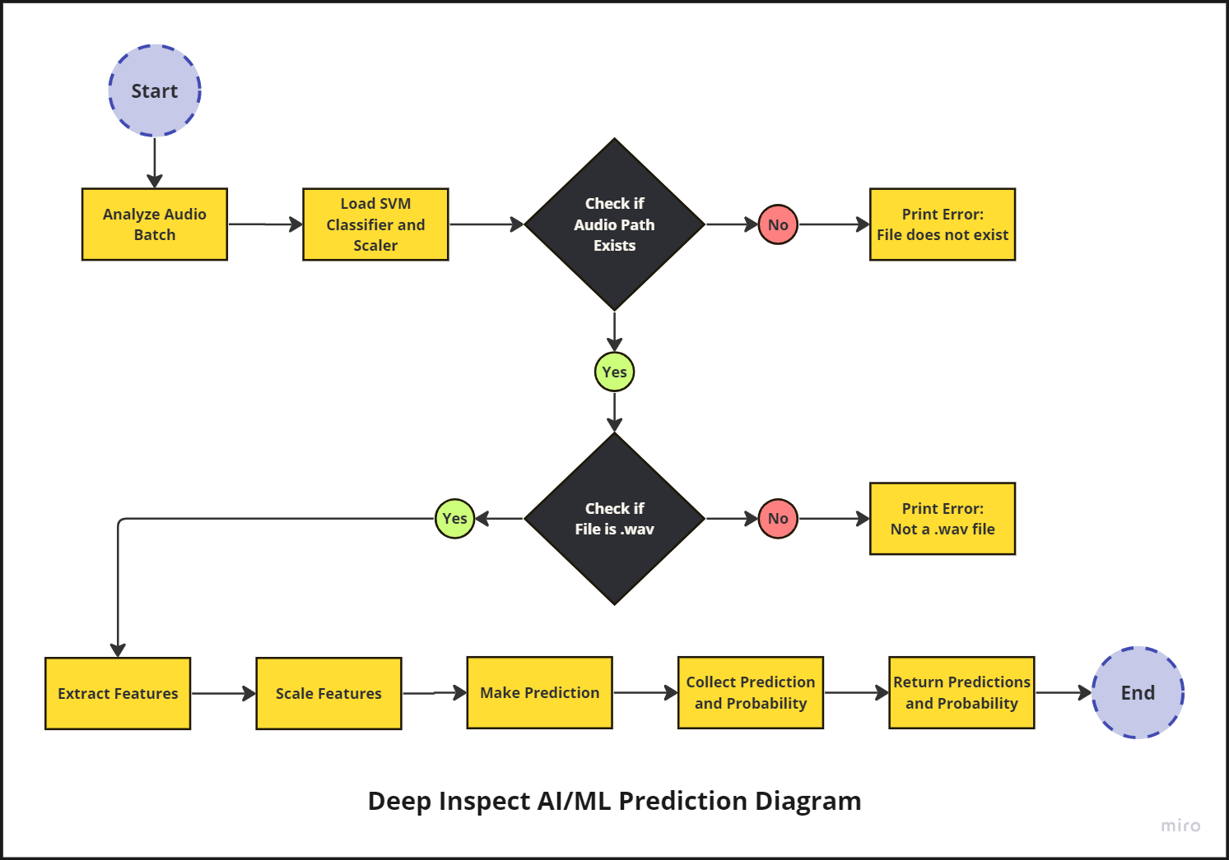
AI/ML model

Slide 34
06
System Architecture

Slide 35
System Architecture
Components:
Chrome Extension: User interface for recording/uploading audio files.
Python Backend: Manages file uploads, processes audio, and extracts features.
AI/ML Model: SVM classifier to predict deepfake audio.

Slide 36
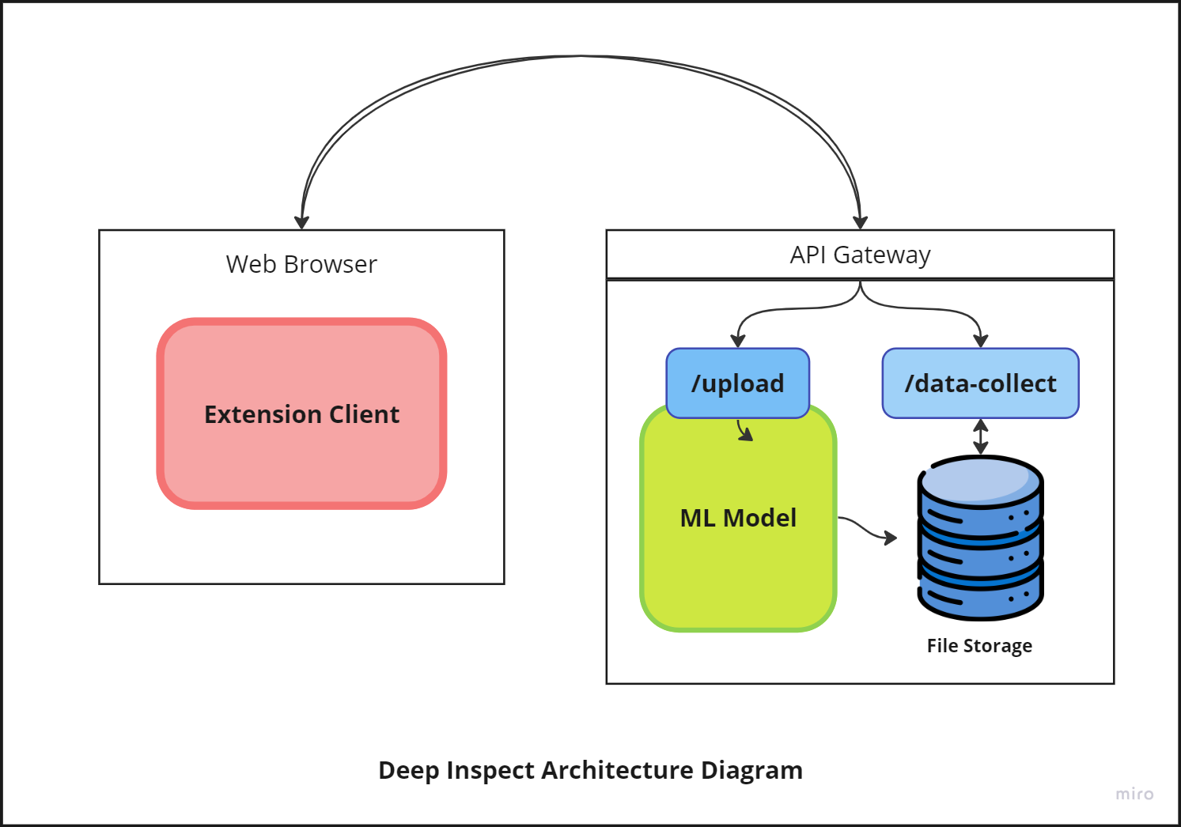
System Architecture

Slide 37
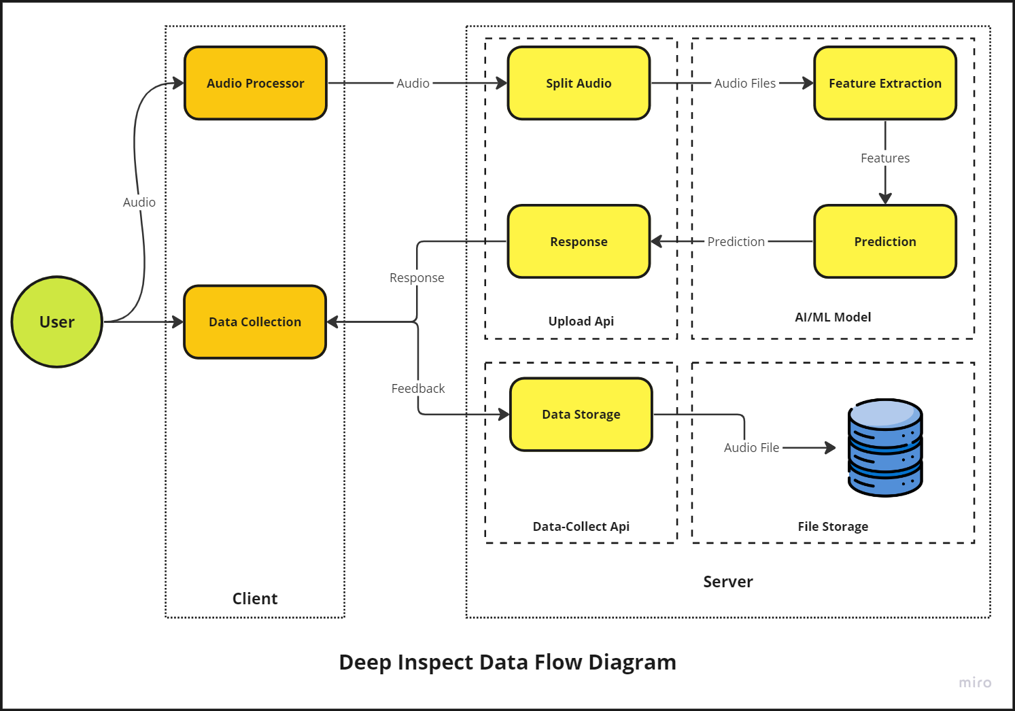
System Architecture

Slide 38
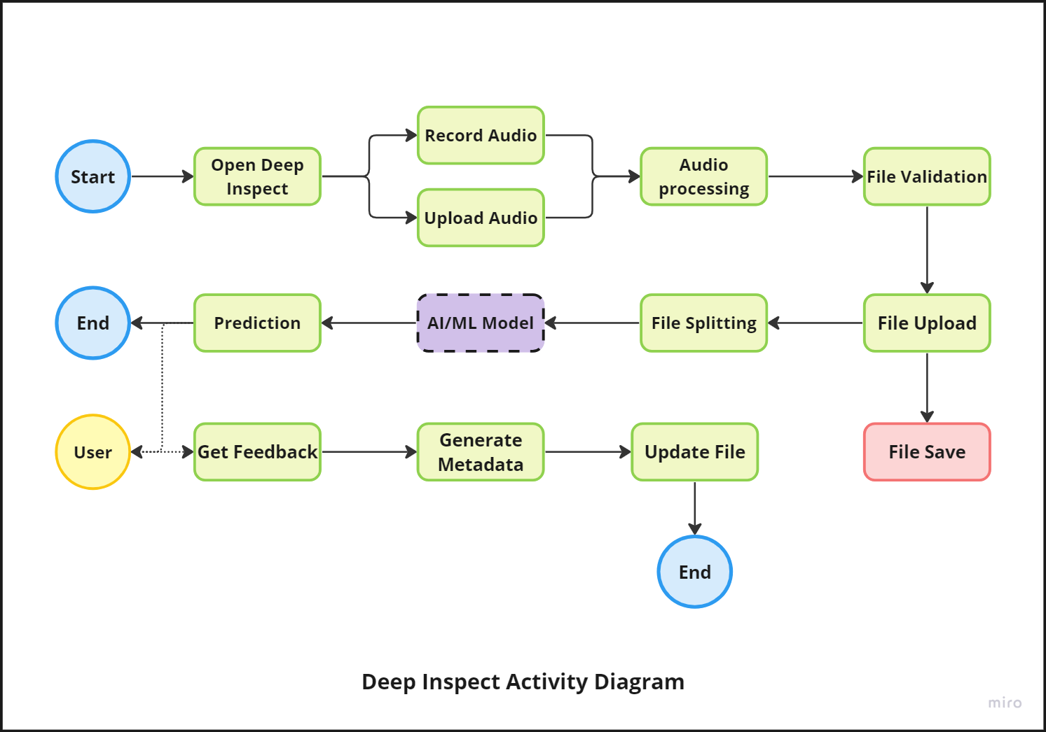
System Architecture

Slide 39
08
Conclusion

Slide 40
Conclusion
Conclusion:
Successfully developed an end-to-end system for detecting deepfake audio.
Integrated a user-friendly Chrome extension with a robust backend and an effective SVM model.
Future Work:
Enhance model accuracy with larger, more diverse datasets.
Implement real-time detection capabilities.
Extend to include video deepfake detection.

Slide 41
09
Open Floor for Questions

Slide 42
Thanks!

